Slide 1

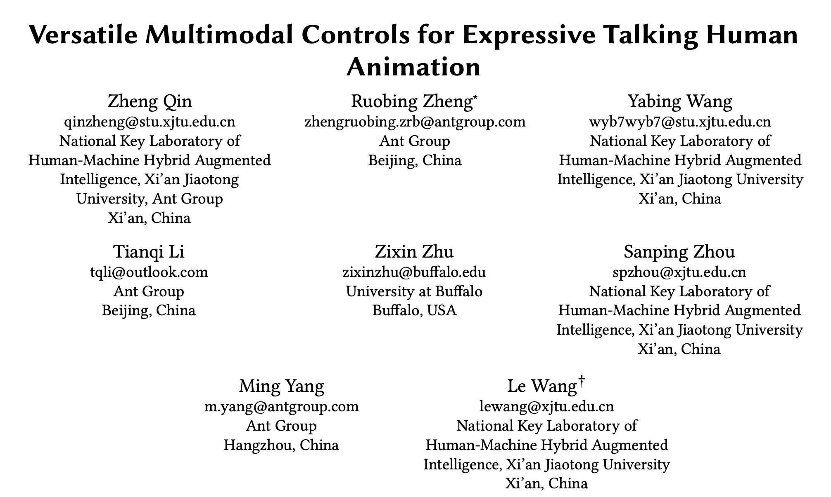

Slide 2
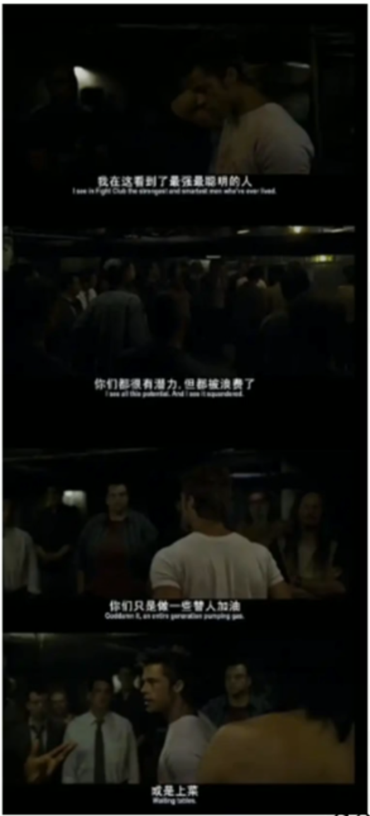
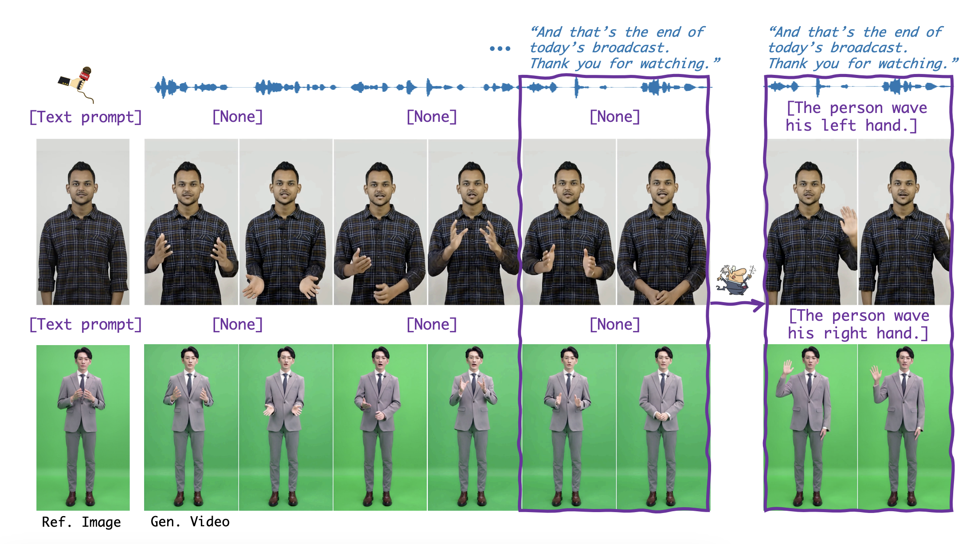
Motivation

Slide 3
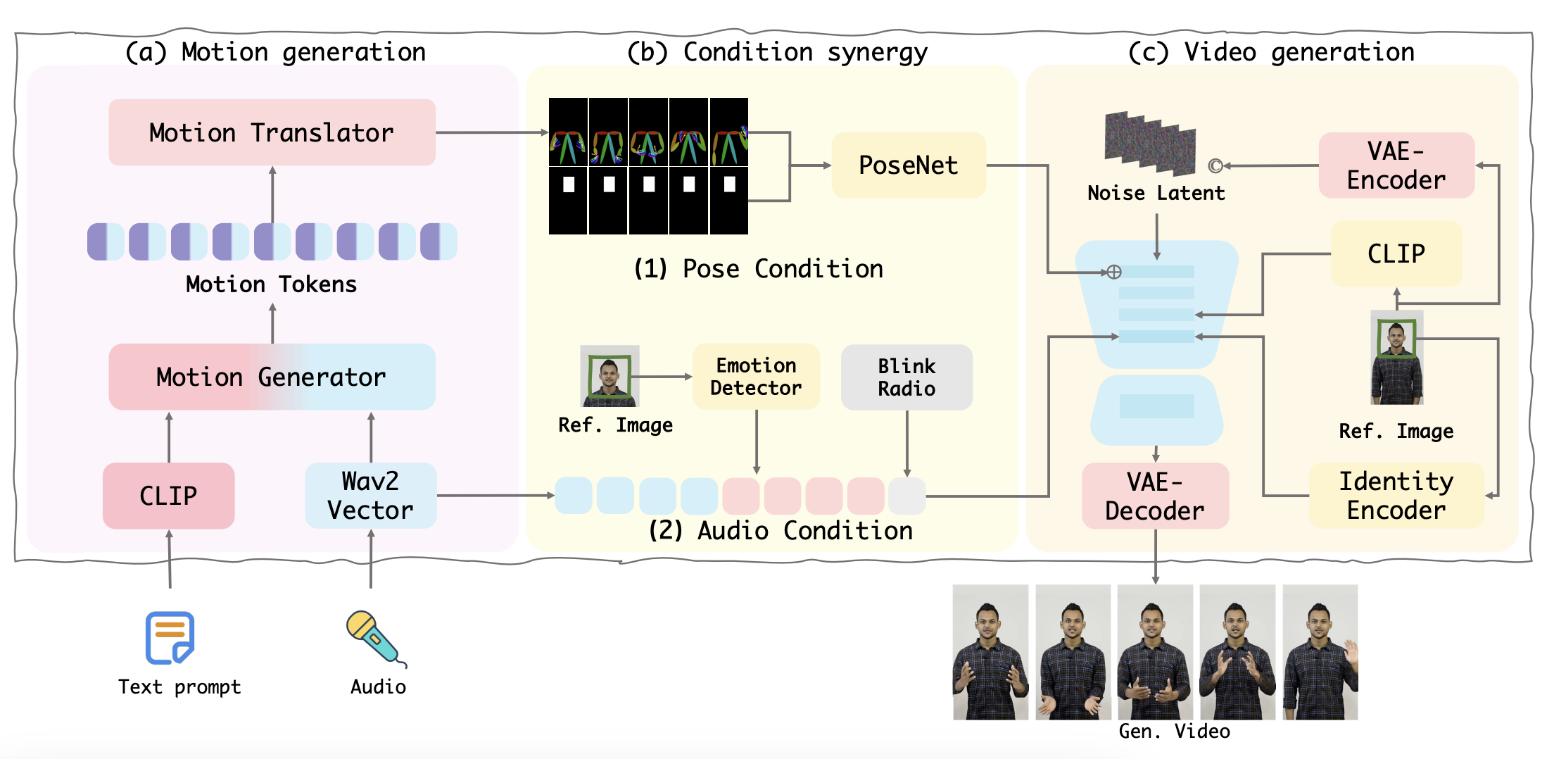
Overview of VersaAnimator

Slide 4
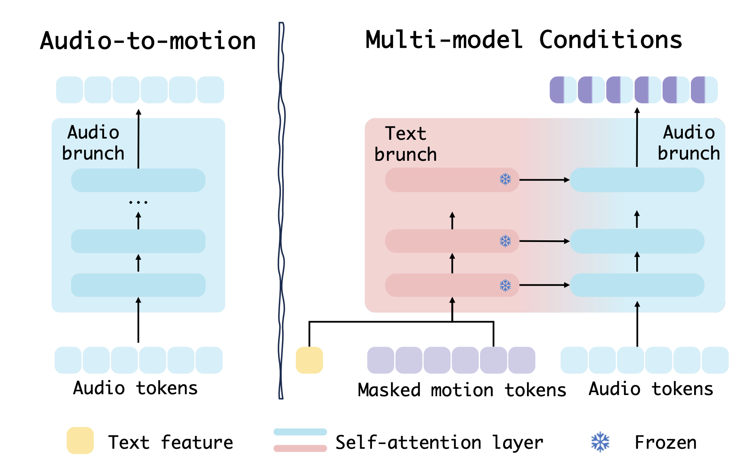
Details Structure of Motion Generator
The two-branch transformer that generates motions conditioned on both audio and text prompts.
The primary audio-to-motion architecture.

Slide 5
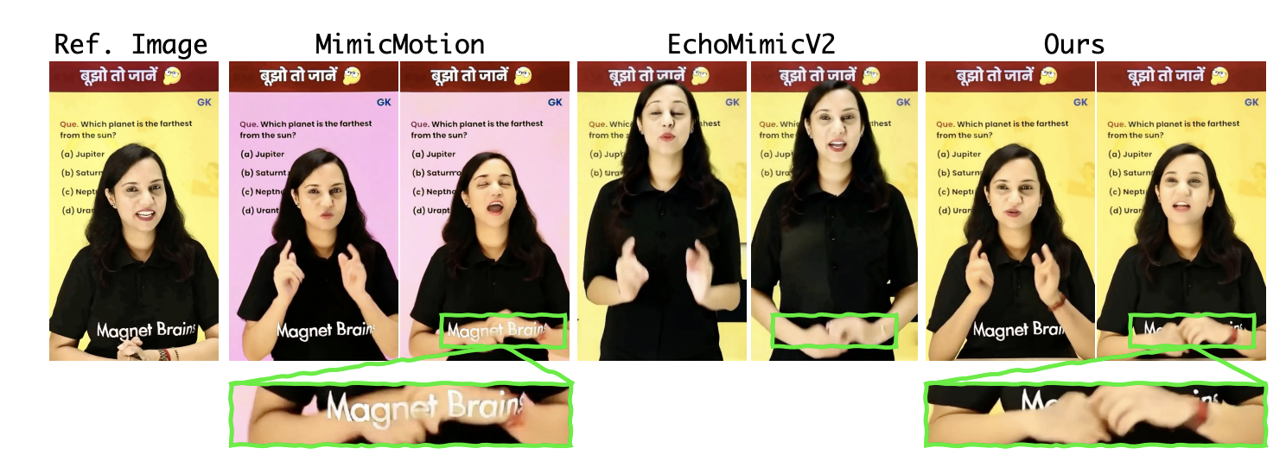
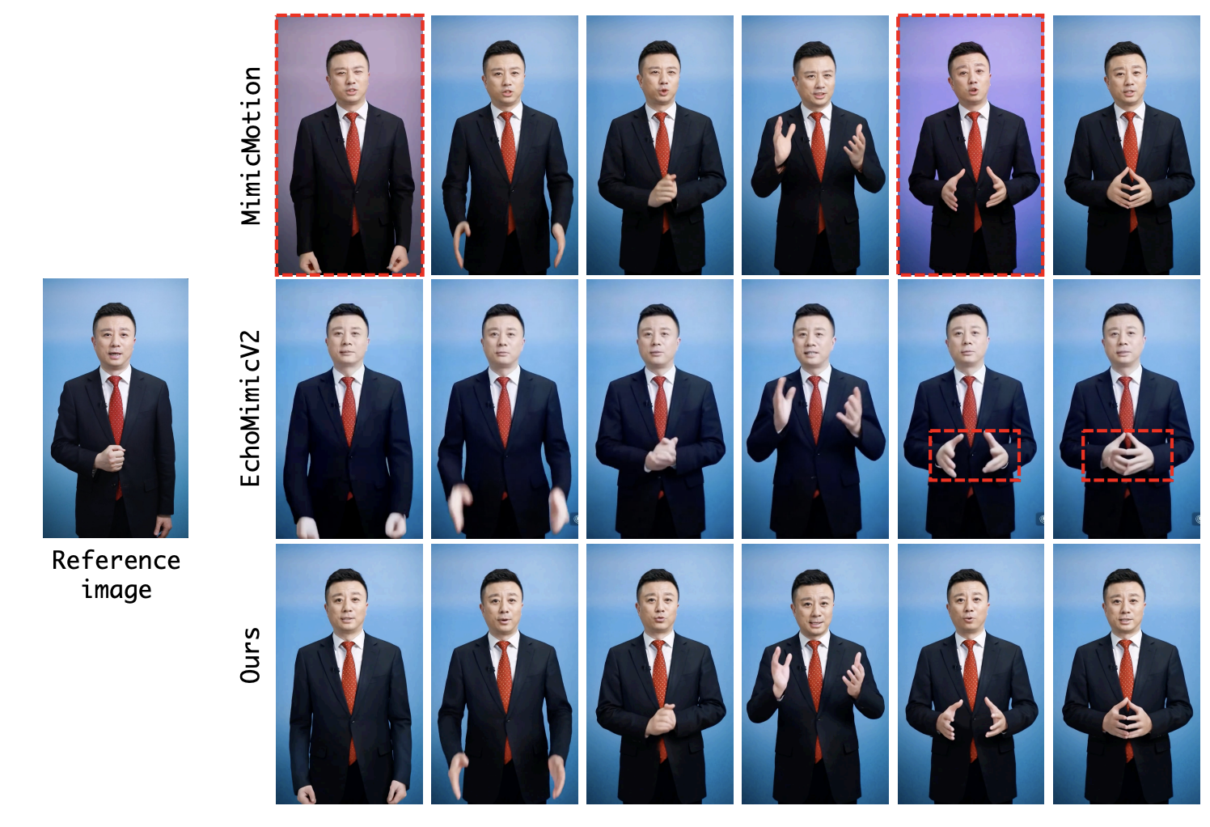
Performance

Slide 6
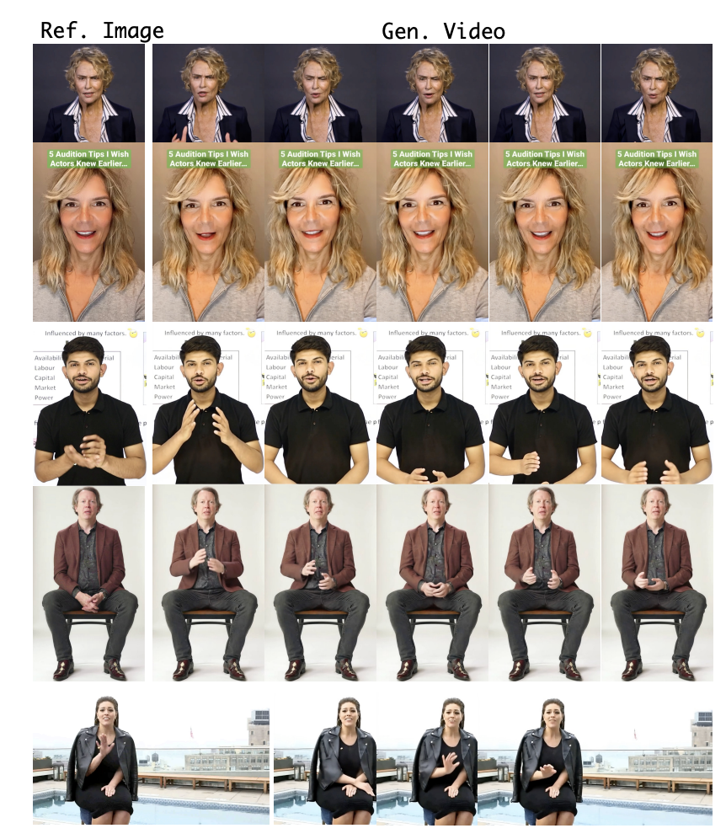
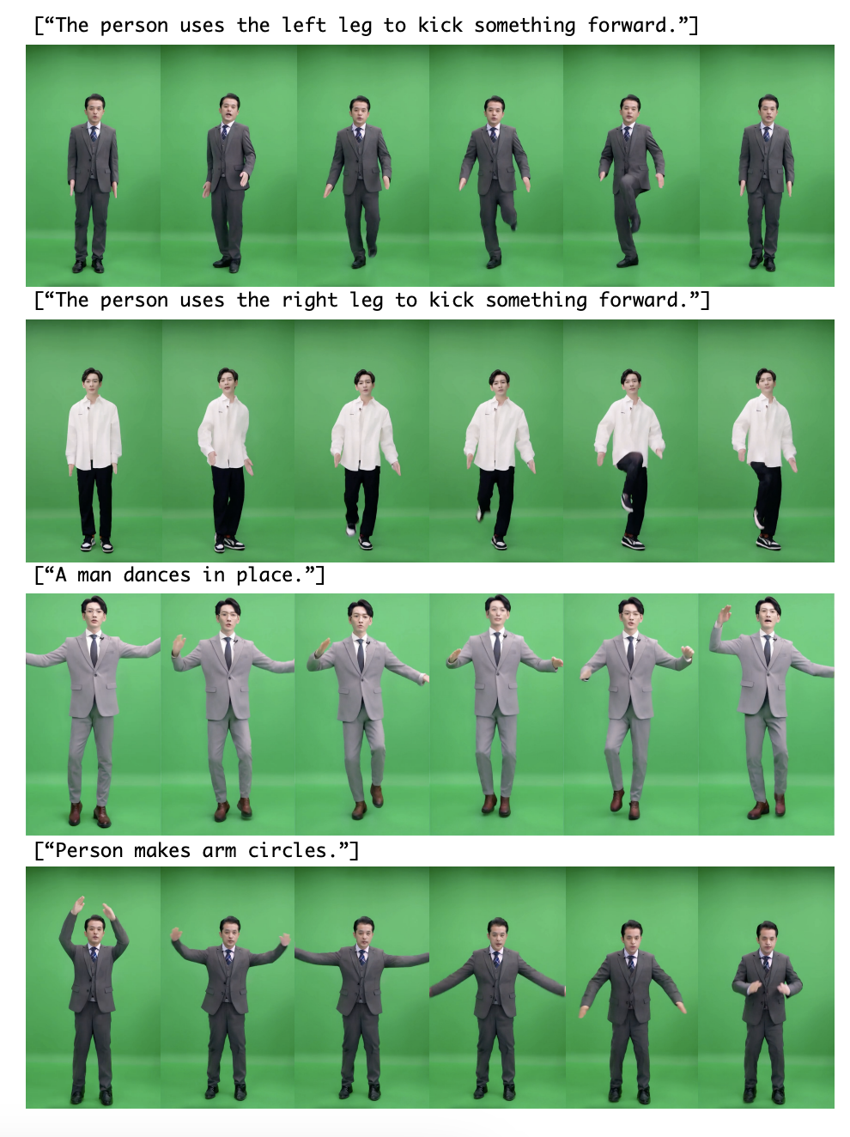

Slide 7
Thank you!
If you are interested in my research or potential collaboration, feel free to reach out.
🔍 Research Interests:
Audio-driven Human Animation
Multi-object Tracking
Multimodal Large Language Models
📧 Email: qinzheng@stu.xjtu.edu.cn

